Slide 1

Market Review
Third Quarter 2019
Notes:
ENTER FORMAL CLIENT NAME, IA NAME AND MEETING DATE

Slide 2
Market Review
Bonds
Stocks
Alternatives
The third quarter of 2019 was another choppy one for financial markets—up in July, down in August, back up in September—as investors continued to weigh the overall health of the global economy against a host of uncertain macro factors including but not limited to the length of the current economic cycle, the implications for an extended U.S.-China trade war, an inverted yield curve and other recessionary precursors, slowing global growth, and central bank monetary policy.
Foreign stocks likewise rode a roller-coaster quarter; however, their rebound in September wasn’t enough to see them keep pace with U.S. stocks, at least in dollar terms, as the U.S. dollar appreciated versus other currencies, which dragged on foreign market returns for dollar-based investors.
Bond yields around the world continued to move lower in the third quarter as deflation concerns took hold. The benchmark 10-year Treasury yield ended the quarter at 1.68%, down from a 2% yield at the end of the second quarter, and down from a little over 3.2% this time last year.
Source: Morningstar Direct. Data as of 9/30/2019.

Slide 3
Trade Policy Versus Monetary Policy Tug Of War
The Current U.S. Expansion Is Now The Longest on Record
Economic signals are mixed, and analysis of the current economic environment continues to be challenging.
On one side, we have a still-solid U.S. economy that has grown for a record number of consecutive years.
On the other side, global economic growth remains weak and consensus expectations are for further slowing.
The expansive monetary policies of central banks around the world continue to present an unknown risk factor.
Source: National Bureau of Economic Research. Data as of 09/30/2019.

Slide 4
Consumer Confidence Remains High
A pattern of uncertainty and volatility has persisted in consumer confidence for much of the year.
Escalation in trade and tariff tensions in late August led to a fall from near-highs during the last month of the quarter.
Continued uncertainty may increase investors’ skepticism about the expansion.
Source: Bloomberg. Data as of 9/30/2019.

Slide 5
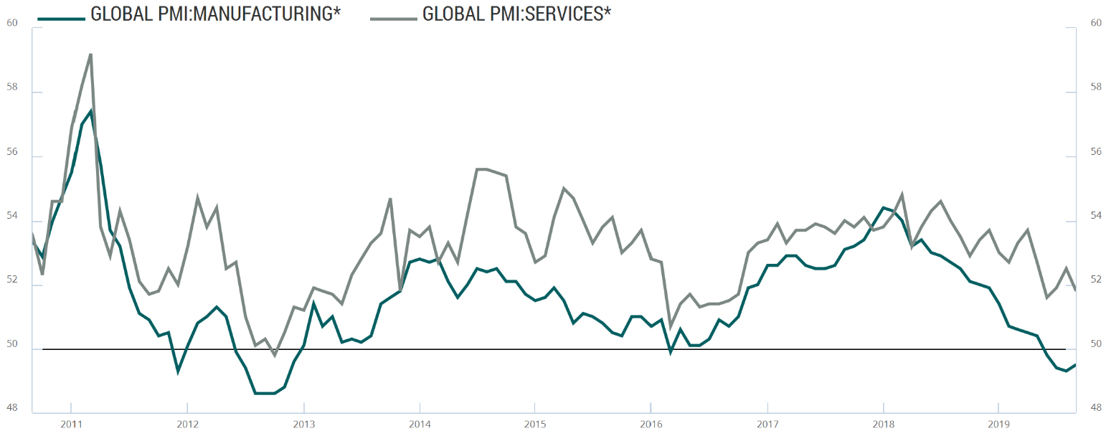
The Service Sector Has Softened Much Less Than Manufacturing
Global Purchasing Managers’ Index (PMI)
----------- Manufacturing ------------- Services (non-manufacturing)
Europe Debt Crisis
U.S. Debt-Ceiling Crisis
Fed Rate at 0%,
Starts QE3
Extends Expansion
Oil Price Collapse
China Slowdown
Global Weakness
Fed Holds Rates Steady
Extends Expansion
Trade Conflict
Fed 2017-18 Tightening
Fed Rate Cuts…
Above 50 suggests economic expansion
Below 50 suggests economic contraction
While measures of manufacturing activity are slowing, global services activity, which represents upward of 70%-plus of the global economy (and more than 80% of U.S. GDP) still looks solid.
The longer a China-U.S. trade agreement remains elusive, the weaker the economy will get as corporations further delay capital expenditures and hiring decisions, not to mention the direct impact already felt by the manufacturing sector.
Easing monetary policy may support a pickup in manufacturing activity extending the expansion.
BCA Research. *Source: MARKIT / J.P. Morgan. Data as of 9/30/2019.
Notes:
On the one hand, the US economy remains in fairly decent shape, thanks in large part to the services (or non-manufacturing) sectors of the economy, which represent upwards of 70% of global GDP and 80% of US GDP.
As we can see in this chart, the Global Services index, while declining, is still in expansionary territory, driven by a strong US consumer, healthy household balance sheets, growing wages, tight labor market and strength in the housing market.
On the other hand, clearly, uncertainty around global trade is having a negative effect on manufacturing activity and business confidence. As we can in this chart, the global manufacturing PMI has fallen into contractionary territory and is at its lowest reading since June 2009.
Business confidence has also plunged. The Conference Board’s CEO Confidence index sank to its lowest level since Q1 2009, which suggests that capital expenditures will remain subdued until the first half of 2020. Not surprisingly, lack of confidence is being blamed on the trade war and slower global growth.
So, one of the key questions going forward, is the degree to which weakness in manufacturing and business confidence spreads to the services sector and the broader economy.
Manufacturing output has declined as a share of output from more than 25% in 1960 to just 11% today as the economy has become much more services oriented. So, a contraction in manufacturing may not necessarily mean a contraction for the overall economy. Indeed, in 2012 and 2016 the manufacturing index fell into contractionary territory; however, the US economy was able to avoid recession.
Still, the slowdown in manufacturing cannot be ignored. The longer a trade agreement with China remains elusive, the greater the potential for the slowdown in manufacturing to spill over to the broader economy. Indeed, the Global Services PMI has been declining and is at its lowest level in three years.

Slide 6
Treasury Yield Curve Inversion Possible Signal of Impending Recession
U.S. Treasury Spread: 10-Year Minus 3-Month
The yield curve (3-month T-bill vs. 10-year Treasury) has been inverted for a few months.
Treasury yield curve inversions have preceded each of the seven prior recessions.
But, lag times from inversion to recession have been long and variable, ranging from six to 23 months. There have also been two inversions that were recession “false alarms”
Source: Board of Governors of the Federal Reserve System. Weekly data as of 9/27/2019.

Slide 7
The Fed Has a Mixed Record Using Rate Cuts to Prevent Recessions
Fed Funds Target Rate
Fed rate cuts do not necessarily prevent a recession from happening.
The last three recessions in 1990, 2000, and 2008 all occurred despite the Fed cutting rates prior to the recessions’ start.
Notable periods of rate cut success were in 1995/96, and again in 1998 when recession was avoided—or delayed.
The impact of the two rate cuts in the third quarter remains to be seen.
Chart concept: Guggenheim Investments. Source: Board of Governors of the Federal Reserve System. Recession as defined by the National Bureau of Economic Research (NBER). Data as of 9/24/2019.

Slide 8
The Benefit From Additional Rate Cuts Will Likely Be Limited
After nine rate hikes, the fed funds rate is barely above levels where it has ended most other easing cycles. Moreover, the Fed has historically cut rates by 5%–7% during a recessionary easing cycle, and there will be little room to cut rates before hitting the “zero lower bound.”
Shaded regions represent NBER-defined recessions. Source: Federal Reserve. Data as of 9/30/2019.

Slide 9
Investment Outlook
Our base-case macroeconomic scenario assumes moderate trend economic growth, both in the United States and globally, and corporate earnings growth and interest rates normalize over our five-year tactical investment time horizon.
The likelihood of a U.S. recession over the near term (six to 12 months) has increased, and a trade war further increases the odds. While the precise timing is highly uncertain, we think a U.S. recession is very likely within our five-year tactical horizon—the business cycle has not been repealed.
The base case also implies low expected returns for both U.S. stocks and U.S. core bonds. As such, our portfolios are tilted toward opportunities we believe offer more attractive risk-adjusted return potential—specifically, non-U.S. stocks, non-core fixed-income strategies, and alternative strategies.
Asset Class | Outlook and Positioning
U.S. Stocks | U.S. stocks are overvalued and their medium-term (five-year) return potential is unattractive. We maintain meaningful exposure to U.S. stocks but remain underweight relative to our strategic, or neutral, allocation.
Developed International Stocks | Valuations for European stocks are attractive and potential excess returns over U.S. stocks are in the upper single digits over the medium term. We have meaningful exposure to international stocks, with a slight overweight position in Europe.
Emerging-Market Stocks | Corporate earnings growth is recovering yet remains far below the peak reached before/during the financial crisis. Valuations for emerging-market stocks remain attractive relative to U.S. stocks. We maintain a slight overweight to emerging-market stocks.
Investment-Grade Bonds | We’re underweight to investment-grade bonds in favor of flexible core bond funds, unconstrained and absolute-return-oriented funds, and floating-rate loan funds we believe have the ability to generate higher returns and better manage their sensitivity to interest rate changes.
Alternative Strategies | We own a mix of alternative strategies we believe improve the overall risk-adjusted return potential of our portfolios, with mid-single-digit return potential for liquid strategies and different risk and return drivers than traditional stocks and bonds.

Slide 10
Disclosure
Asset Class Descriptions:
Domestic Investment-Grade Bonds (Barclays Capital U.S. Aggregate Bond Index): We are currently using the Vanguard Total Bond Market Index Fund to represent the Barclays Capital U.S. Aggregate Bond Index, an index of domestic investment grade bonds.
Floating Rate Loans (S&P/LSTA Leveraged Loan Index): We are currently using the S&P/LSTA Leveraged Loan Index to represent an index of floating rate loans.
High Yield Bonds (Merrill Lynch U.S. High Yield Master Cash Pay Index): We are currently using the Merrill Lynch U.S. High Yield Master Cash Pay Index to represent an index of domestic high yield bonds.
Domestic Larger-Cap Stocks (S&P 500 Index): We are currently using the Vanguard 500 Index Fund to represent the S&P 500, an index of primarily domestic larger-cap stocks.
Domestic Smaller-Cap Stocks (Russell 2000 Index): We are currently using the Russell 2000 Index iShares Exchange Traded Fund (ETF) to represent the Russell 2000, an index of primarily domestic smaller-cap stocks.
International Developed-Market Stocks (FTSE Developed ex North America Index): We are currently using the Vanguard FTSE Developed Markets Exchange Trade Fund (ETF) to represent an index of international developed-market stocks. Prior to May 2013, this Vanguard Exchange Traded Fund followed MSCI-EAFE. Prior to the July 2007 inception of Vanguard MSCI EAFE ETF, we use iShares MSCI EAFE Index from September 2001 to July 2007, and the MSCI EAFE Index adjusted for 0.35% expenses annually prior to September 2001.
International Emerging-Market Stocks (FTSE Emerging Markets Index): We are currently using the Vanguard FTSE Emerging Markets Index Exchange Traded Fund (ETF) to represent an index of emerging market stocks. Prior to January 2013, this Vanguard Exchange Traded Fund followed the MSCI Emerging Markets Index. Prior to the March 2005 inception of Vanguard MSCI Emerging Markets ETF, we use iShares MSCI Emerging Markets Index from May 2003 to March 2005, and the MSCI Emerging Markets Index adjusted for 0.67% expenses annually prior to May 2003.
Managed Futures: We are currently using an average of the AQR Managed Futures Strategy HV, Natixis ASG Managed Futures Strategy Y, and PIMCO TRENDS Managed Futures Strategy.
Arbitrage Strategies: We are currently using an average of the AQR Diversified Arbitrage Strategy (ADAIX) and the Arbitrage Event Driven Strategy (AEDNX).
Advisory services offered through Alsworth Capital Management, LLC, an independent Registered Investment Advisory firm. Broker Dealer services offered through Cadaret, Grant & Co., Inc. Member FINRA/SIPC. Alsworth Capital Management, LLC and Cadaret, Grant & Co. are separate entities.
Projections and opinions in this presentation are attributed solely to Shane Alsworth and Alsworth Capital Management, LLC.

